Slide 1
Computer Organization & Assembly Language (Lecture 12)
Omar Bin Samin
Lecturer
Institute of Management Sciences, Peshawar.

Slide 2
Shift Instructions
Shifting means to move bits right or left inside an operand
The shift instructions affect Carry Flag
The shift instructions include:
Logical Left Shift (SHL)
Logical Right Shift (SHR)
Arithmetic Left Shift (SAL)
Arithmetic Right Shift (SAR)

Slide 3
Logical Shift Instructions
The bits of a word are shifted left or right
On one end, the bit shifted out is lost
The lost bit is copied in Carry Flag
On the other end, a ‘0’ is shifted in

Slide 4
Logical Left Shift (SHL)
Logical Right Shift (SHR)
CF
1 | 0 | 0 | 0 | 0 | 0 | 0 | 1
0
CF
1
0 | 0 | 0 | 0 | 0 | 0 | 1 | 0
0
1 | 0 | 0 | 0 | 0 | 0 | 0 | 1
CF
0 | 1 | 0 | 0 | 0 | 0 | 0 | 0
1
CF

Slide 5
Arithmetic Shift Instructions
The arithmetic shift operation treats the data as a signed integer

Slide 6
Arithmetic Left Shift (SAL)
Arithmetic Right Shift (SAR)
CF
1 | 0 | 0 | 0 | 0 | 0 | 0 | 1
0
CF
1
0 | 0 | 0 | 0 | 0 | 0 | 1 | 0
1 | 0 | 0 | 0 | 0 | 0 | 0 | 1
CF
1 | 1 | 0 | 0 | 0 | 0 | 0 | 0
1
CF

Slide 7
Task 01
Logical left shift: (10010111)2
Logical right shift: (10010111)2

Slide 8
Task 02
Arithmetic left shift: (10010111)2
Arithmetic right shift: (10010111)2

Slide 9
Example 01
Show the values of AX for all executable instructions.
[org 0x100]
mov al, 11001100b
shl al,1
mov al, 11001100b
shr al,1
mov al, 11001100b
sal al,1
mov al, 11001100b
sar al,1
mov ax,0x4c00
int 0x21

Slide 10
Task 03
Show the values of AX for all executable instructions.
[org 0x100]
mov al, 11001100b
shl al,2
mov al, 11001100b
shr al,3
mov al, 11001100b
sal al,2
mov al, 11001100b
sar al,3
mov ax,0x4c00
int 0x21

Slide 11
Shifting Uses
Shifting can be utilized for in:
Multiplication
Division

Slide 12
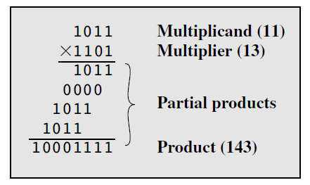
Unsigned Binary Multiplication

Slide 13
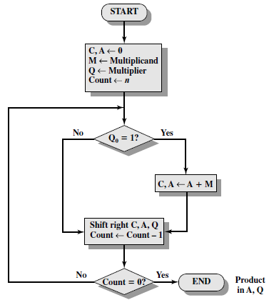

Slide 14
Example 02
2
x 4
M
Q
C | A | Q | M | n
0 | 000 | 100 | 010 | 3
0 | 000 | 100
0 | 000 | 010 |  | 2
0 | 000 | 010
0 | 000 | 001 |  | 1
0 | 000 | 001
0 | 010 | 001
Answer: A Q
001 000 = (8)2
0 | 001 | 000 |  | 0

Slide 15
Task 04
Solve the following using flow chart of unsigned binary multiplication:
7
x 1
3
x 3
9
x 0

Slide 16
Example 03
Implement Example 02 in Assembly Language.
[org 0x0100]
mov bl, [multiplicand] ;M
mov al, [multiplier] ;Q
mov ah, [accumulator] ;A
mov bh, [carry] ;C
mov cl, 8 ;n
outerloop:
mov dl, al
shl al,7
cmp al,0x80
mov al, dl
jnz shift
add ah, bl
jnc shift
mov bh, 10000000b
shift:
shr ax, 1
add ah, bh
mov bh,0
loop outerloop
mov ax, 0x4c00
int 0x21
multiplicand: db 2
multiplier: db 5
accumulator: db 0
carry: db 0

Slide 17
Rotate Instructions
Rotate means to move bits either right or left in a loop
The rotate instructions affect Carry Flag
The rotate instructions include:
Rotate Left (ROL)
Rotate Right (ROR)
Rotate Carry Left (RCL)
Rotate Carry Right (RCR)

Slide 18
Rotate Left (ROL)
Rotate Right (ROR)
CF
1 | 0 | 0 | 0 | 0 | 0 | 0 | 1
CF
1
0 | 0 | 0 | 0 | 0 | 0 | 1 | 1
1 | 0 | 0 | 0 | 0 | 0 | 0 | 1
CF
1 | 1 | 0 | 0 | 0 | 0 | 0 | 0
1
CF

Slide 19
Rotate Carry Left (RCL)
Rotate Carry Right (RCR)
CF
0
1 | 0 | 0 | 0 | 0 | 0 | 0 | 1
CF
1
0 | 0 | 0 | 0 | 0 | 0 | 1 | 0
1 | 0 | 0 | 0 | 0 | 0 | 0 | 1
0
CF
0 | 1 | 0 | 0 | 0 | 0 | 0 | 0
1
CF

Slide 20
Example 04
Show the values of AX for all executable instructions.
[org 0x100]
mov al, 11001100b
rol al,1
mov al, 11001100b
ror al,1
mov al, 11001100b
rcl al,1
mov al, 11001100b
rcr al,1
mov ax,0x4c00
int 0x21

Slide 21
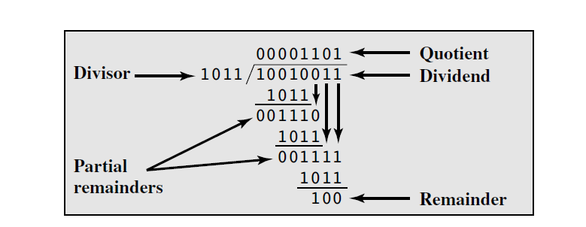
Unsigned Binary Division

Slide 22
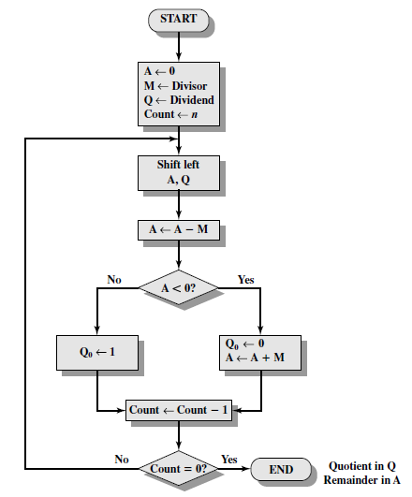

Slide 23
Example 05
3
2
Q
M
A | Q | M | n
00 | 11 | 10 | 2
01 | 10
11 | 10
01 | 10
01 | 10 |  | 1
11 | 00
01 | 00
01 | 01
Answer: A = Remainder: (01)2
Q = Quotient: (01)2
01 | 01 |  | 0

Slide 24
Task 05
Solve the following using flow chart of unsigned binary division:
7
1
2
9
8
8

Slide 25
Task 06
Implement Example 04 in Assembly Language utilizing shift and rotate instructions.

Slide 26
Extended Shifting
Let us assume, that we only have 8-bit registers (al, ah, bl, bh, cl, ch, dl and dh) and we are multiplying 8-bit data with other 8-bit data. Then the answer we get will be of 16-bit
In other words, we have a number of 16-bits achieved by any arithematic operation and the storage location is of 8-bits. We want to shift this 16-bit data using 8-bit register or memory

Slide 27
Recall,
Combination of SHL and RCL yeilds in Shift Left Double Word (SHLD)
SHL:
CF
1 | 0 | 0 | 0 | 0 | 0 | 0 | 1
0
RCL:
CF
0
1 | 0 | 0 | 0 | 0 | 0 | 0 | 1
CF
1 | 0 | 0 | 0 | 0 | 0 | 0 | 1
0
CF
1 | 0 | 0 | 0 | 0 | 0 | 0 | 1

Slide 28
Similarly,
Combination of SHR and RCR yeilds in Shift Right Double Word (SHRD)
SHR:
0
1 | 0 | 0 | 0 | 0 | 0 | 0 | 1
CF
RCR:
1 | 0 | 0 | 0 | 0 | 0 | 0 | 1
0
CF
0
1 | 0 | 0 | 0 | 0 | 0 | 0 | 1
CF
1 | 0 | 0 | 0 | 0 | 0 | 0 | 1
CF

Slide 29
For linking above explaination with SHLD and SHRD, let us assume, word means 1-byte (which actually is wrong, but only for understanding we are assuming word = byte)
For Shift Left Double Word (SHLD)
SHL on LSB
RCL on MSB
For Shift Right Double Word (SHRD)
SHR on LSB
RCR on MSB
In reality, extended shifting works with word (16-bit or 32-bit) not with byte (16-bit).

Slide 30
Example 06
Extended left shift using SHL and RCL.
[org 0x0100]
shl byte [num1], 1
rcl byte [num1 + 1], 1
mov ax, 0x4c00
int 0x21
num1: dw 0x20F0

Slide 31
Example 07
Extended left shift.
[org 0x0100]
mov ax, 0x4080
mov bx, 0x8080
Shld ax,bx,1
mov ax, 0x4c00
int 0x21

